Slide 1
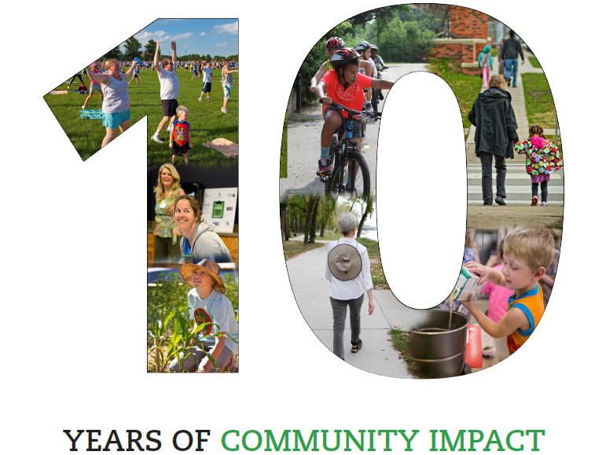
Notes:
Hunger. Chronic disease. Lives cut short.
Preventable suffering.
For the past 10 years, LiveWell Douglas County has been a resident-led coalition working to fulfill our vision of: “communities where we all thrive.”
Our mission is “Leading a movement to build communities that support the health and well-being of all.”
Six years ago, LiveWell sharpened its focus to serve as the primary implementation of the “Healthy Built Environment” and “Healthy Food for All” areas of the community health plan. We had heard from nearly 2,000 Douglas County residents about the issues that were “top of mind” for them; food insecurity was a top concern. We learned from vulnerable members of our community, including a woman experiencing homeless having lunch at LINK, who said that she would “trade that whole table of sweets for just one carrot.”

Slide 2
Community health improvement plan
Poverty and jobs
Behavioral health
Safe and affordable housing
Access to healthy food and physical activity
Equity & Discrimination
Notes:
LiveWell continues to lead efforts to address food security and a healthy built environment laid out in our new 5-year community health improvement plan, starting with those in greatest need.

Slide 3
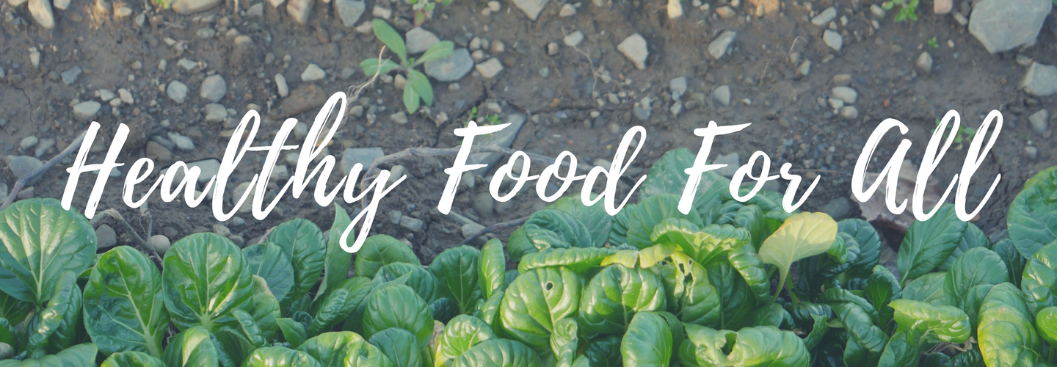
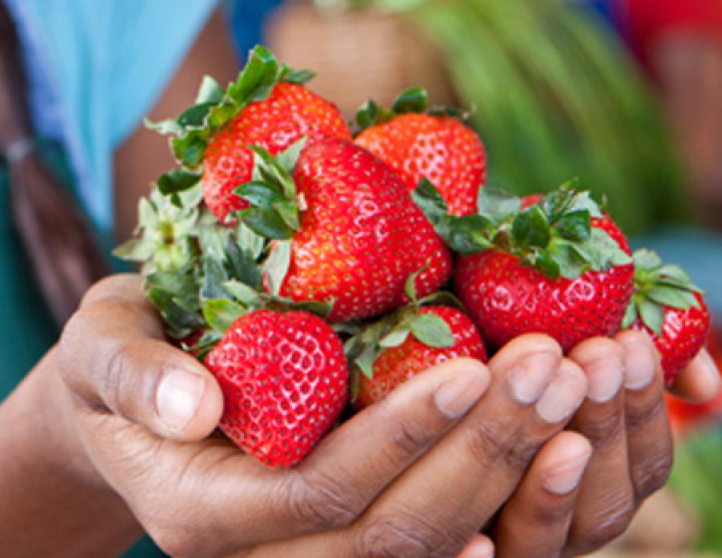
Reducing Food Insecurity
Notes:
We can, and we must, work to end hunger in Douglas County.
“Many of the people I work with, the only reason they eat is because of places like Just Food, the LINK Kitchen, and Salvation Army. We work with quite a few people who don’ have an income at all, for whatever reason…mental illness, disability, whatever other issues come up that has caused them to be homeless. And so, for a lot of those people, the only places they can go to eat, are places like Just Food, the LINK Kitchen, and Salvation Army. Without Just Food, I have quite a few people that would probably be starving and/ or eating out of a dumpster.”
For these residents of our community, we must ensure access to food that will fill their bellies and nourish their bodies.
Speaking of the ability to access healthy food from a local pantry, a resident shared, ““It improves your overall quality of life. It really impacts my life. I don’t have to just eat Top Ramen or cans of pork and beans.”
Story upon story from local residents, as well as feedback received from community surveys, led to a number of community-determined strategies for making improvements to reduce food insecurity in our Douglas County communities. These include -
Ensuring enhanced food access for populations facing transportation barriers. We are thrilled to share Just Food has acquired a vehicle to be used as a mobile food pantry, deployed to areas of most critical need.
Growing food recovery practices and policies to increase the supply of safe, nourishing food to those in need
Strengthening the FuelGood Healthy Pantries Initiative to promote adoption of health-promoting policies and practices in food pantries – where our most vulnerable neighbors obtain their sustenance
Removing barriers to and strengthening utilization of public food assistance programs for families with children and seniors, including School breakfast, dinner, and summer meal programs; SNAP; WIC; Double Up Food Bucks; CHAMPPS; Meals on Wheels; and Commodity Supplemental Food Program for seniors
Supporting advocacy efforts
Extending food pantry evening/ weekend availability
And growing “Hunger and Health” efforts to enhance integration of social services and health care (such as diabetes screening and self-management support at local pantries)
While exciting progress is already being made, there is much to do. First, we must continue to “work upstream,” including supporting the Poverty and Jobs work group being convened (first meeting July 10). Become involved in a work group. Lead a healthy food drive. Support policies that support a living wage. Raise awareness in your circles of influence. Serve as a founding partner to help establish funds to hire an executive director so critical to moving this work forward.
We have much to be proud of, but we must not relent. Please join us as we continue to make hunger history in Douglas County.

